Slide 1


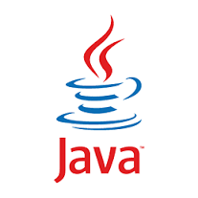
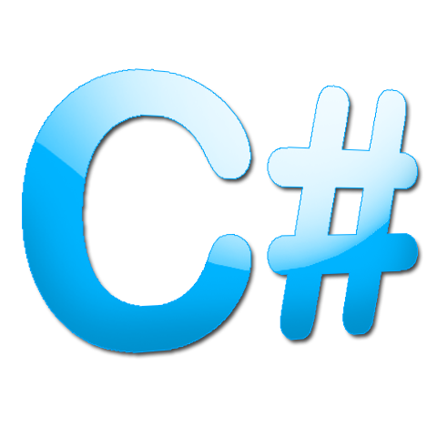
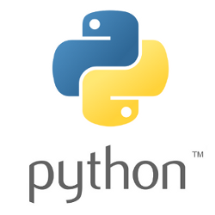



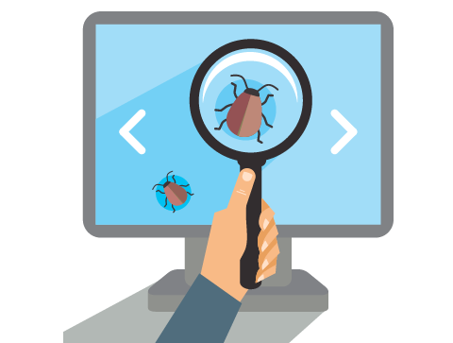
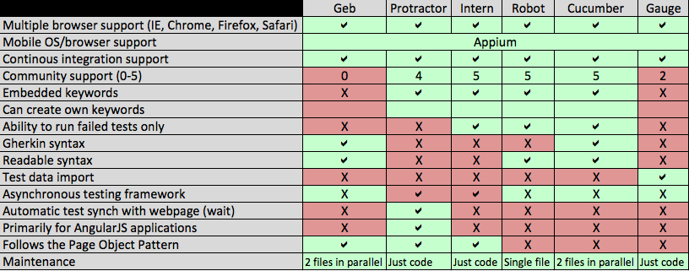



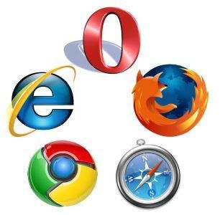


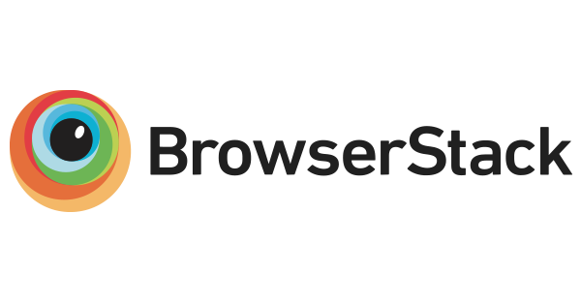



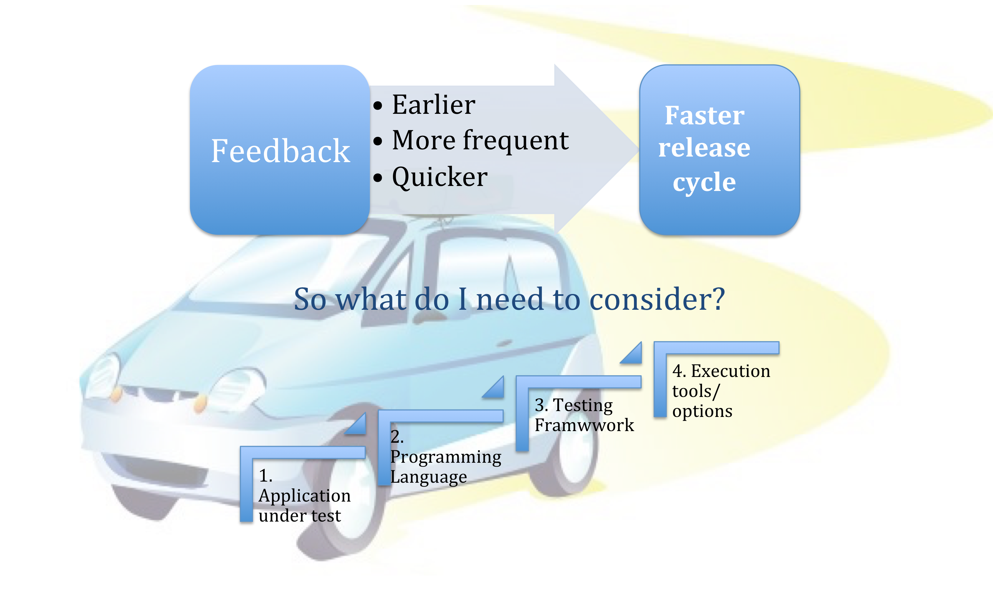
A Journey Into Testing Frameworks and Beyond
1. Application Under Test
Purpose of App?
Mobile app?
Desktop app?
2. Programming Language
3. Automated Testing Frameworks
4. Execution options/tools
Running tests locally
Development Product Team QA | May 2016 Hussain Ashraf

